Slide 1
Room Ambiance
Vulsan Bianca Maria, gr. 30414

Slide 2
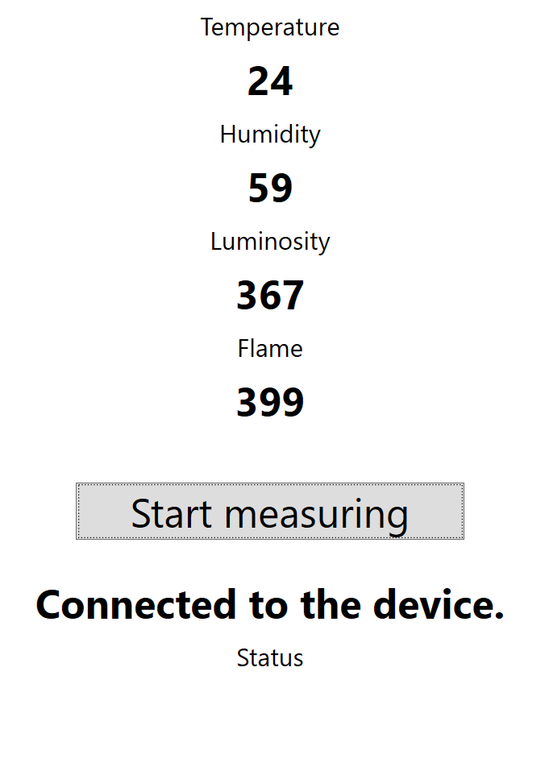
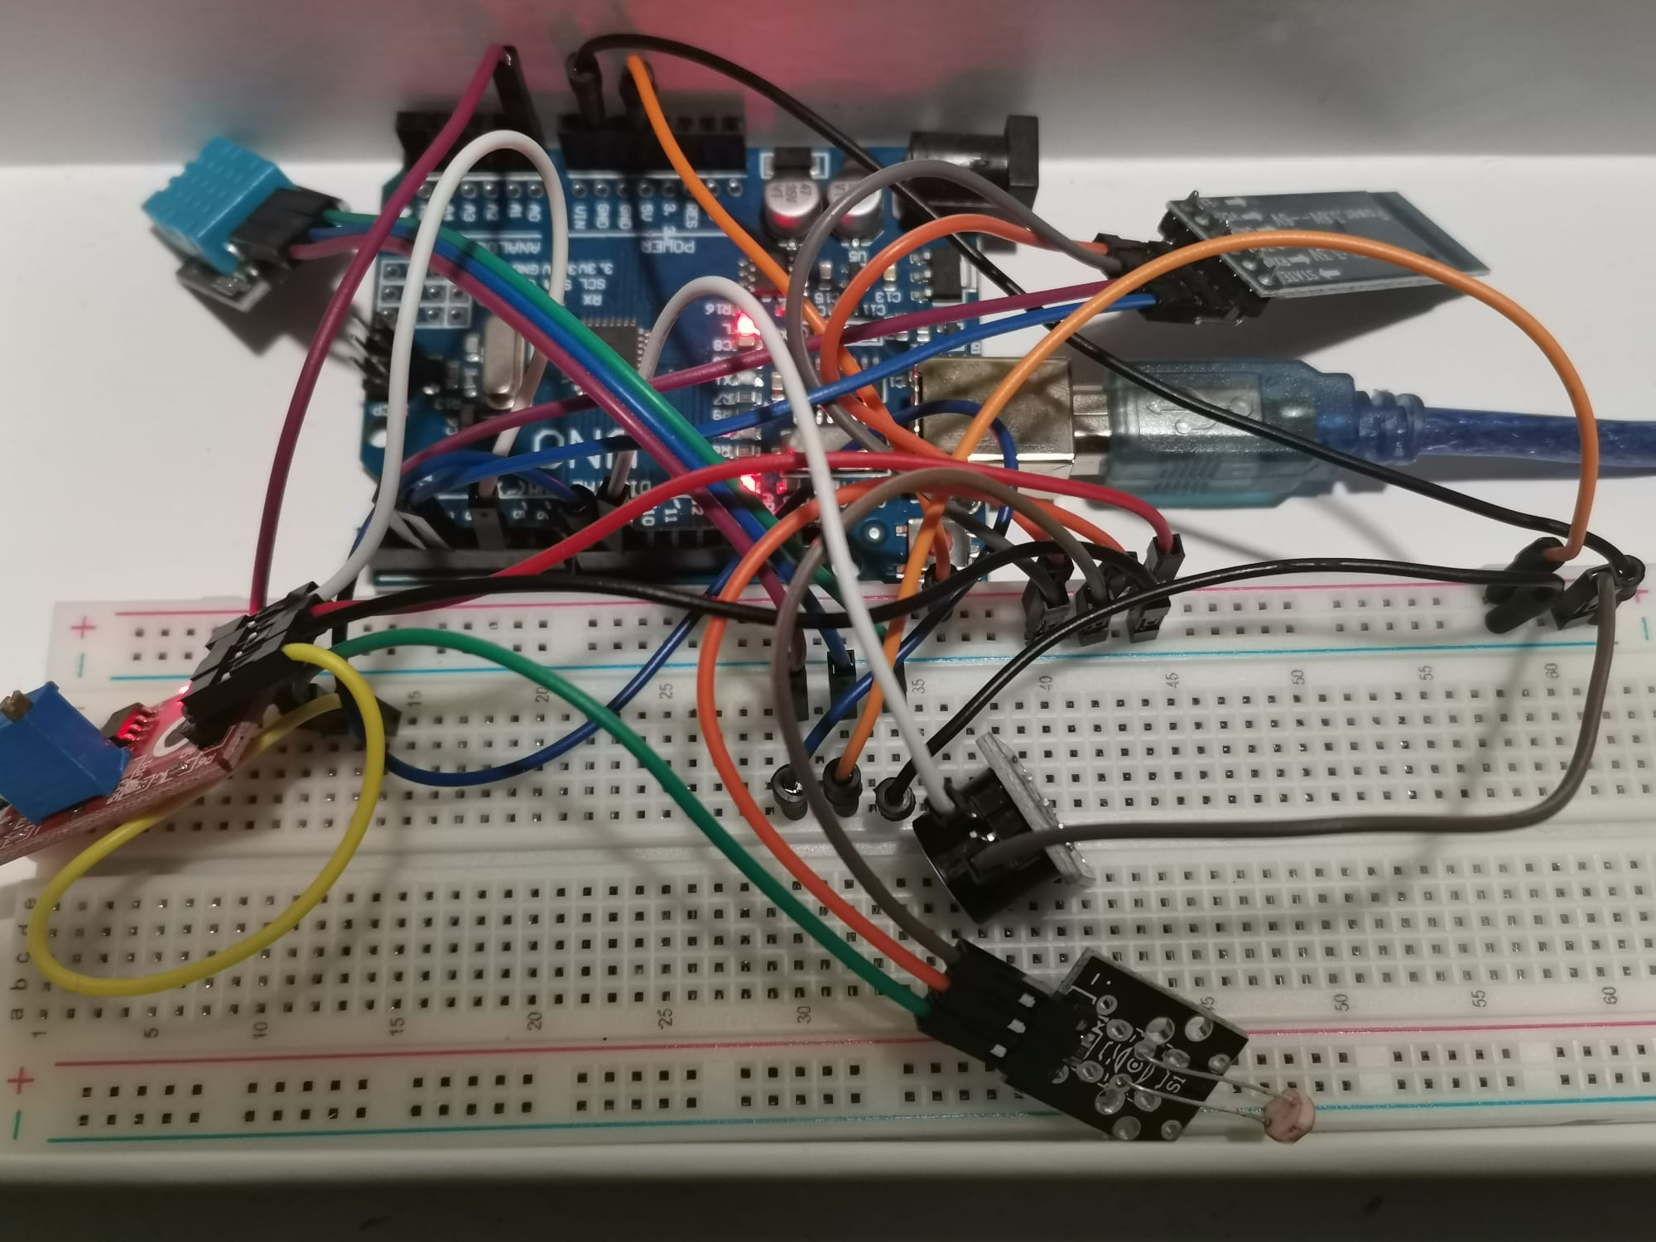
Temperature and Humidity sensor
Bluetooth module
Flame detector
Photoresistor
Buzzer

Slide 3
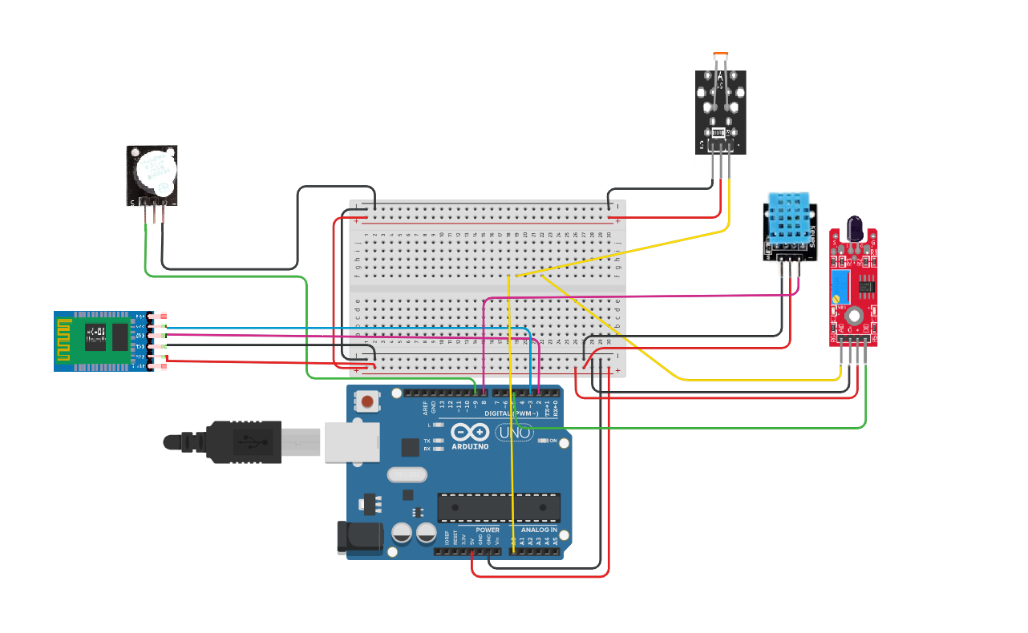

Slide 4
List of components
Hardware | Software
Arduino Uno board + breadboard | Arduiono application installed
HC-05 bluetooth module | Visual Studio or other application for writing C# code
Buzzer KY-012
DHT11 temperature and humidity sensor
Flame detector KY-026
Photoresistor KY-018
An 1 Ohm resistor and a 2 Ohms resistor for the bluetooth module

Slide 5
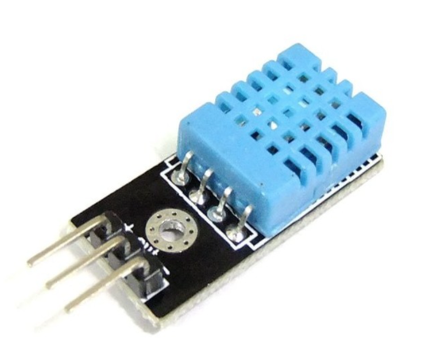
DHT11 Temperature and Humidity Sensor
The DHT11 is a digital temperature and humidity sensor. It uses a capacitive humidity sensor and a thermistor to measure the surrounding air and spits out a digital signal on the data pin. An important aspect is that it requires careful timing to collect data, as one can get new data from it once every 2 seconds. The specifications for this sensor are listed below:
Supply Voltage: +5 V
Temperature range :0-50 °C error of ± 2 °C
Humidity :20-90% RH ± 5% RH error
Interface: Digital

Slide 6
The physical concept
The protocol DHT11 uses is “unusual”. It transmits the bits very fast as short impulses. As Arduino does not have an operation system, it functionate closer to the real time than Raspberry Pi and reads more easily the impulses. But, even so, the information must be encoded in a special way, because the embedded function pulseIn() is not fast enough.
DHT11 transmits 5 bytes packets. So, taking into consideration that each byte has 8 bits, the packet has 5*8 = 40 bits.

Slide 7
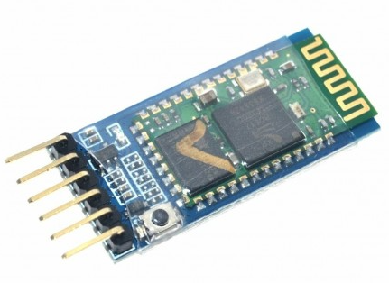
HC-05 Bluetooth Module
Bluetooth serial modules allow all serial enabled devices to communicate with each other using Bluetooth. It has six pins: Key/EN, VCC, GND, TXD (Transmit Serial Data), RXD (Receive Serial Data) and State pin.

Slide 8
The physical concept
HC-05 Chip is known as Bluetooth SPP (Serial Port Protocol) module. It is Used for transparent wireless serially connecting setup. It is fully dedicated Bluetooth V2.0+EDR (Enhanced Data Rate) 3Mbps Modulation Along with complete 2.4GHz radio transceiver. It has CSR Blue core 04-External single chip Bluetooth system with Complementary Metal Oxide Semiconductor technology and with AFH (Adaptive Frequency Hopping Feature). It has the Dimensions as small as 12.7mmx27mm.

Slide 9
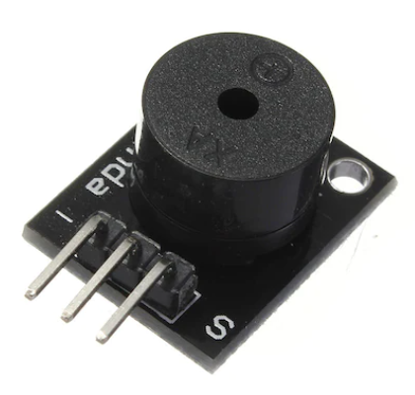
Buzzer KY-012
When this sensor is powered, this active buzzer generates a sound with the frequency of 2.5kHz. The active buzzer module, unlike the passive module KY-006 does not require a square wave voltage to generate a tone - if a voltage of min. 3.3V is applied to its signal pin, the required square wave voltage is generated in the buzzer independently.
Tech Specs:
Min/Max Operating Voltage +3.3V to +5V
Maximum Current: 30mA/ 5VDC
Resonance Frequency: 2500Hz ± 300Hz
Minimum Sound Output 85Db @ 4in (10cm)
Storage Temperature: -22°F to 221°F (-30°C to 105°C)
Operating Temperature: -4°F to 158°F (-20°C to 70°C)
Dimensions: 0.73in X 0.59in (18.5mm X 15mm)

Slide 10
The physical concept
This sensor consists only of an active buzzer that has an oscillator inside it so just power the buzzer and it will emit a sound, typically at the 2500Hz frequency.
Through this module it is not possible to determine the frequency of the sound, for this function it is necessary a passive buzzer.

Slide 11
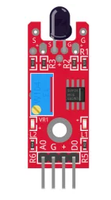
Flame detector KY-026
The KY-026 Flame Sensor module detects infrared light emitted by fire. This module has both digital and analog outputs and a potentiometer to adjust the sensitivity. Commonly used in fire detection systems.
Tech Specs:
IR detector for detecting fire / flames
Spectrum 760 nm to 1100 nm
Adjustable switching contact with Poti
Operating voltage 3.3 V - 5 V
LED1: Shows that the sensor is supplied with voltage
LED2: Shows that the sensor detects a flame

Slide 12
The physical concept
Sensor for flame wavelengths between 760 nm to 1100 nm infrared is most sensitive 60 degree detection sensor
Two outputs mode:
AO: analog output- real-time output voltage signal on the thermal resistance; DO: when the temperature reaches a certain threshold- the output high and low signal threshold adjustable via potentiometer
The sensor has 3 main components on its circuit board. First, the sensor unit at the front of the module which measures the area physically and sends an analog signal to the second unit, the amplifier. The amplifier amplifies the signal, according to the resistant value of the potentiometer, and sends the signal to the analog output of the module. The third component is a comparator which switches the digital out and the LED if the signal falls under a specific value.
The sensitivity can be controlled by adjusting the potentiometer.

Slide 13
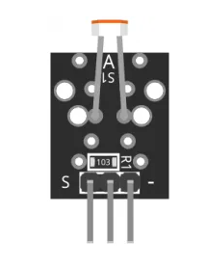
Photoresistor KY-018
The KY-018 Photoresistor module is used to measure light intensity. The resistance will decrease in the presence of light and increase in the absence of it. The output is analog and determines the intensity of light.
Tech Specs:
Opening Voltage: 3.3V to 5V
Output Type: Analog

Slide 14
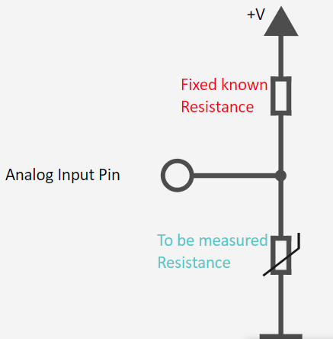
The physical concept
Contains an LDR resistor whose resistance value decreases with brighter environment. This resistance can be determined with the help of a voltage divider, where a known voltage is divided over a known (10KΩ) and an unknown (variable) resistance. Using this measured voltage, the resistance can then be calculated - the exact calculation is included in the code examples below.

